Slide 1
CRC Card

Slide 2
Introduction to CRC Cards
Invented in 1989 by Kent Back and Ward Cunningham: Wilkinson 1995; Ambler 1995;
An index card consists of heavy paper cut to a standard size, used for recording and storing small amounts of discrete data. It was invented by Carl Linnaeus, around 1760.
CRC Card = Class Responsibility Collaborator Card
a collection of standard index cards that have been divided into three sections,
A class represents a collection of similar objects,
a responsibility is something that a class knows or does, and
a collaborator is another class that a class interacts with to fulfill its responsibilities.

Slide 3
Format of CRC Cards

Slide 4
What is CRC Card
An effective way to analyze scenarios
First was proposed by Beck & Cunningham as a tool for teaching OO programming.
As a development tool that facilitates brainstorming & enhances communication among developers.
The cards are arranged to show the flow of messages among instances of each class.
As team members walk through the scenario,
they may assign new responsibilities to an existing class,
group certain responsibilities to form a new class or
divide responsibilities of one class into more fine grained ones
Perhaps distribute these responsibilities to a different class.

Slide 5
Contd..
Responsibilities of a class (What information you wish to maintain about it)
Knowing responsibilities
instance of a class must be capable of knowing (the values of its attributes and its relationships)
Example: Student have names, addresses and phone no
Doing responsibilities
things that an instance of a class must be capable of doing
Example: Students enroll in seminars, drop seminars
A class is able to change the values of the things it knows, but unable to change the values of what other classes know

Slide 6
Contd..
Sets of class forms a collaboration
Class does not have sufficient information to fulfill its responsibilities
A class must collaborate with other classes to get the job done
Example: Students enroll in seminars. To do this student needs to know if a spot is available and, if so, students then needs to be added to the seminar

Slide 7
Allows the analyst to think in terms of an instance of a clients, servers, and contracts (request for information or a request to do something)
Client objects – sends a request to an instance of another class for an operation to be executed.
Server objects – receives the request from the client object.
Contracts objects – formalizes the interaction between the client and server objects.
Example:
the card Student requests an indication from the card Seminar whether a space is available, a request for information
Student then requests to be added to the Seminar, a request to do something
Another way: Student simply request Seminar to enroll himself into itself. Then have Seminar do the work of determining if a seat is available and, if so, then enrolling the student and, if not, then informing the student that he was not enrolled

Slide 8
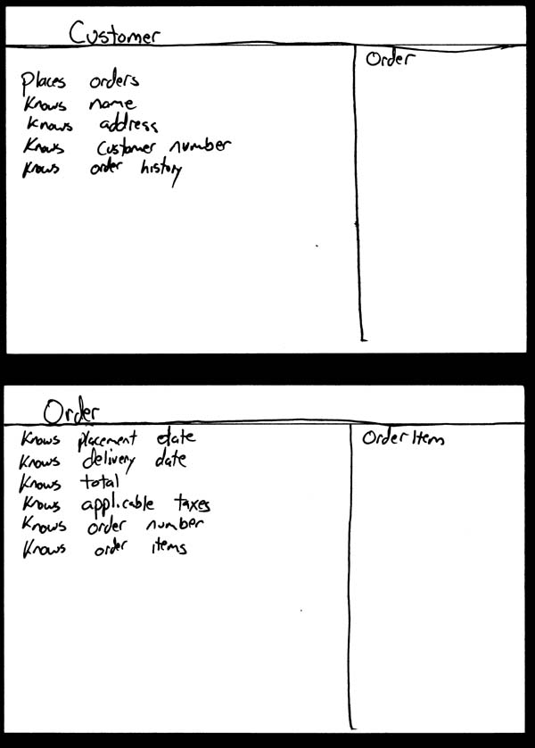
Example….. Hand-drawn CRC cards

Slide 9
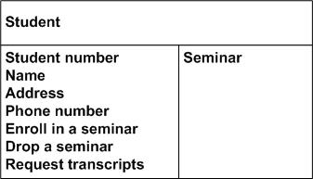
Example… student CRC card

Slide 10
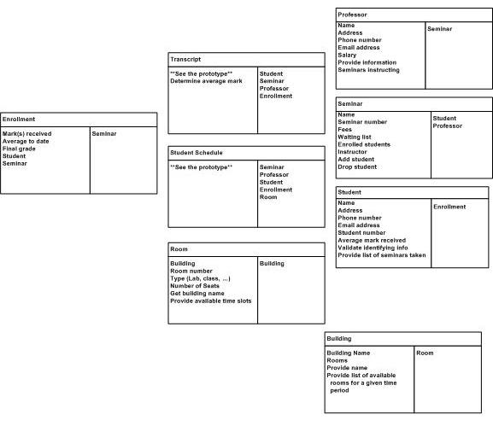
Example: Student CRC card

Slide 11
how do you create CRC models?
Find classes
Find responsibilities
Define collaborators
To identify the collaborators of a class for each responsibility ask yourself "does the class have the ability to fulfill this responsibility?"
Move the cards around
To improve everyone's understanding of the system, the cards should be placed on the table in an intelligent manner.
Two cards that collaborate with one another should be placed close together on the table, whereas two cards that don't collaborate should be placed far apart.
Furthermore, the more two cards collaborate, the closer they should be on the desk. By having cards that collaborate with one another close together, it's easier to understand the relationships between classes

Slide 12
FINDING CLASSES Method:
1. Read specification
2. Work through requirements, highlighting nouns and noun phrases to give candidate classes.
3. Work through candidates, deciding likely classes and rejecting unlikely.

Slide 13
READ SPECIFICATION
If you don't have one, WRITE your own.
The specification should:
describe the goals of the design
discuss the things the system should do
i.e. desired responses to expected inputs

Slide 14
CANDIDATE CLASSES
physical objects e.g. printer, switch
cohesive entities e.g. file, window
categories of classes (may become abstract superclasses)
interfaces both to user and to other programs
attribute values (NOT attributes) e.g. "circle has radius in real numbers" : circle and real are classes; radius is not.

Slide 15
FINDING CLASSES
The process of identifying classes is iterative - some will be missed, others will be amalgamated Likely classes:
any physical objects
any 'cohesive abstractions' e.g. a file
any interfaces to outside world
any categories of class e.g. "there are various types of whatsits"
values of attributes of objects

Slide 16
